Slide 1
REGULATION OF GAS CONCENTRATIONS
Due to cellular respiration, the intake of oxygen and excretion of carbon dioxide must be regulated
.
Control of ventilation (breathing) rate allows the human body to do this.

Slide 2
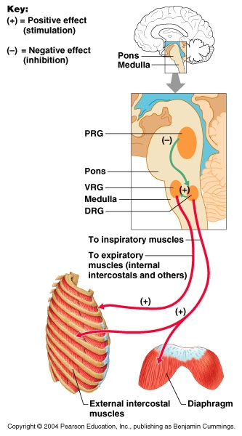
MUSCLES THAT CONTROL VENTILATION
The ventilation of the lungs is caused by the contraction and relaxation of the DIAPHRAGM and INTERCOSTAL skeletal muscles.
The diaphragm is stimulated by the phrenic nerve.
The intercostal muscles are stimulated by the intercostal nerves.

Slide 3
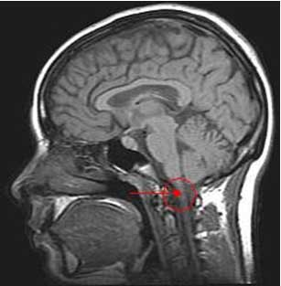
RESPIRATORY MUSCLE control
Phrenic and intercostal nerve impulses are controlled by the respiratory centre within the medulla oblongata of the brain.
There are two regions within the respiratory centre. One that controls inspiration, and the other controls expiration. These two regions work together to coordinate breathing.

Slide 4
CHEMICAL FACTORS AFFECTING ventilation rate
Three chemical factors affect ventilation rate. They are;
Increased carbon dioxide concentration within the blood (main factor)
Decreased oxygen concentration within the bloodstream.
Increased hydrogen ion concentration causes pH level to decrease.

Slide 5
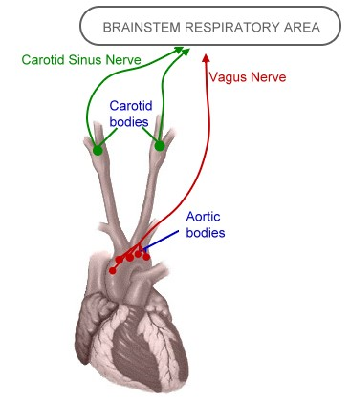
chemoreceptors
Changes in chemical concentrations are detected by CHEMORECEPTORS.
Central chemoreceptors are located in the MEDULLA.
Peripheral chemoreceptors are located in the AORTIC BODY (aorta artery) and CAROTID BODY (carotid arteries in the neck).
Peripheral chemoreceptors

Slide 6
CO₂ concentration
Increase in CO₂ concentration = increase in H⁺ ion concentration.
This increase stimulates central (medulla oblongata) and peripheral chemoreceptors (carotid and aortic)
Central chemoreceptors in medulla oblongata are most sensitive to CO₂ concentration.
Increase CO2 is responsible for 70 – 80% of increase in breathing rate, but can take several minutes.

Slide 7
H⁺ ion concentration
As H⁺ ion concentration increases, pH decreases and blood becomes more acidic
CO2 (carbon dioxide) + H20(water)
H2C03 (carbonic acid) which breaks down into (H+) hydrogen ions & (HCO3-) bicarbonate ions
Decrease in pH stimulates the peripheral chemoreceptors in aortic and carotid bodies.
They transmit this info to respiratory centre in the medulla oblongata which causes an immediate increase in breathing rate.

Slide 8
Voluntary control of breathing from cerebrum
For a short time, the cerebrum can override the medulla and its control of ventilation.
This is important if the person recognises that they are in an environment where there is a dangerous gas.
After a while the build of co2 in plasma causes the respiratory centre in the medulla to force inspiration.
Hyperventilation removes more co2 and provides more o2 than is necessary. Hyperventilation before swimming is dangerous because the individual loses consciousness due to lack of o2 to brain before the urge to breathe occurs.

Slide 9
Regulation of ventilation rate
STIMULUS
Carbon dioxide blood plasma concentration levels slightly increase
Oxygen blood plasma concentration levels slightly decrease
Hydrogen ion increase in blood plasma causing pH decrease (more acidic)
RECEPTOR
Peripheral chemoreceptors in the aortic and carotid bodies detect lower pH and decreased oxygen concentrations.
The peripheral and central chemoreceptors detect increased hydrogen ions and carbon dioxide concentrations.
Nerve impulses are transmitted to the respiratory centre in the medulla.

Slide 10
MODULATOR
Respiratory centre within the medulla sends nerve impulses via the phrenic and intercostal nerves
EFFECTOR
Intercostal nerves act on the intercostal muscles
Phrenic nerve acts on the diaphragm
RESPONSE
Ventilation rate increases
FEEDBACK
Increased oxygen blood plasma concentrations
Decreased carbon dioxide blood plasma concentrations
Decreased hydrogen ions therefore increasing blood pH

Slide 11
EXERCISE AND BREATHING
Physical exercise increases the rate and depth of breathing.
Working skeletal muscles use up oxygen and therefore produce more carbon dioxide during cellular respiration, and the build up of lactic acid as a waste product also increases hydrogen ion concentration. The above feedback system then “kicks in”.
The increased carbon dioxide, not a decreased oxygen concentration (oxygen levels must, and do, remain fairly constant) stimulates the increased ventilation rate. Increased hydrogen ions also have a stimulatory effect.

